Slide 1





Course Feedback
Vraj Shah Daniel Baldwin, Nate Holbus, Feni Pethani

Slide 2



Purpose of Software

Slide 3
Purpose of Software
Create a of mobile version GSU Course Feedback site (MVP)
Improve it (possibly)

Slide 4
Technologies

Slide 5
Technologies
Figma/Flutter - Mock up/ user story
Java
Android Studio
SQLite (example databases)
Github
VScode

Slide 6
Storyboards

Slide 7
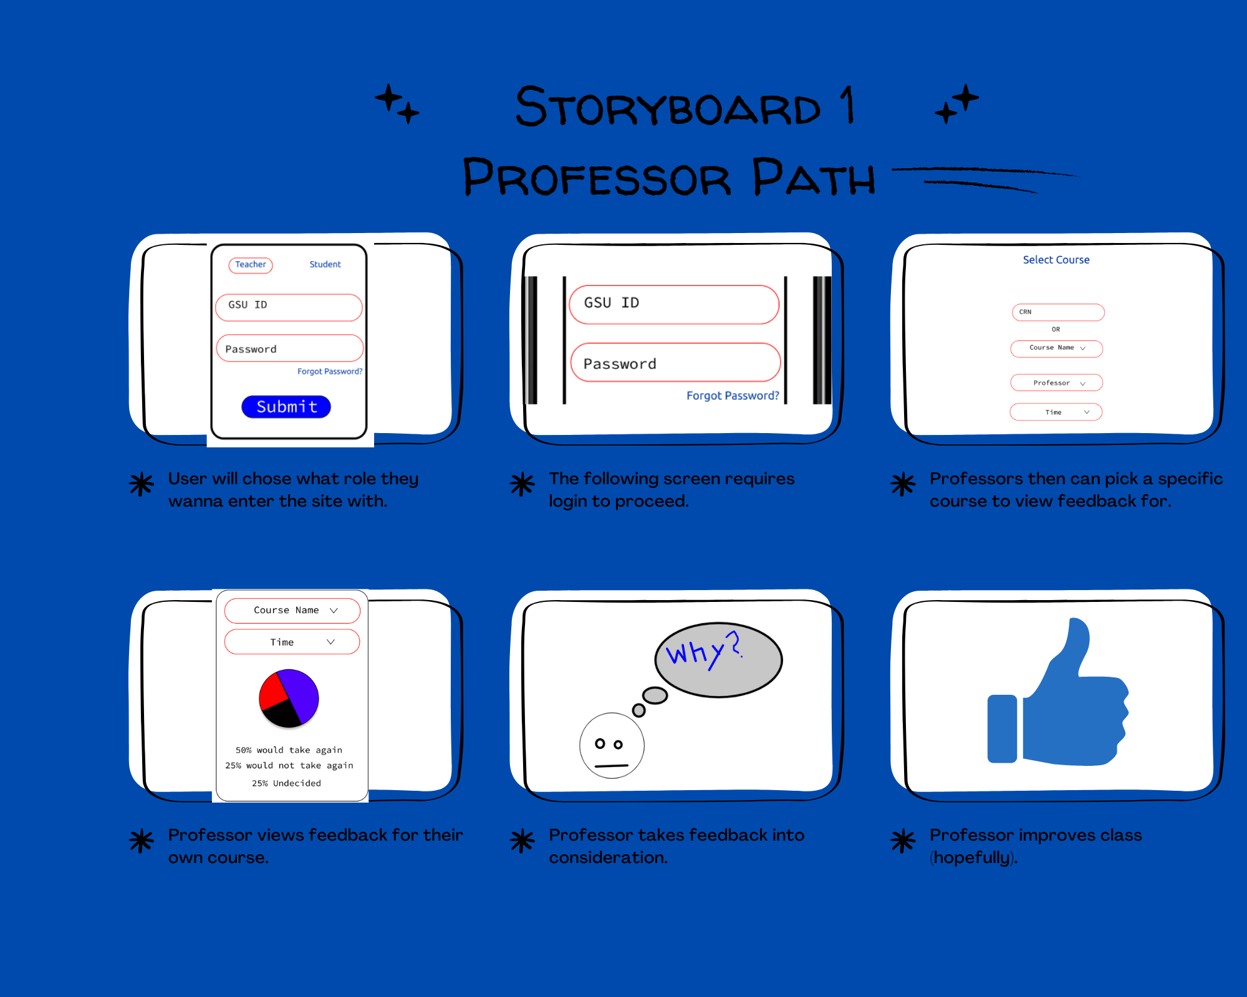

Slide 8
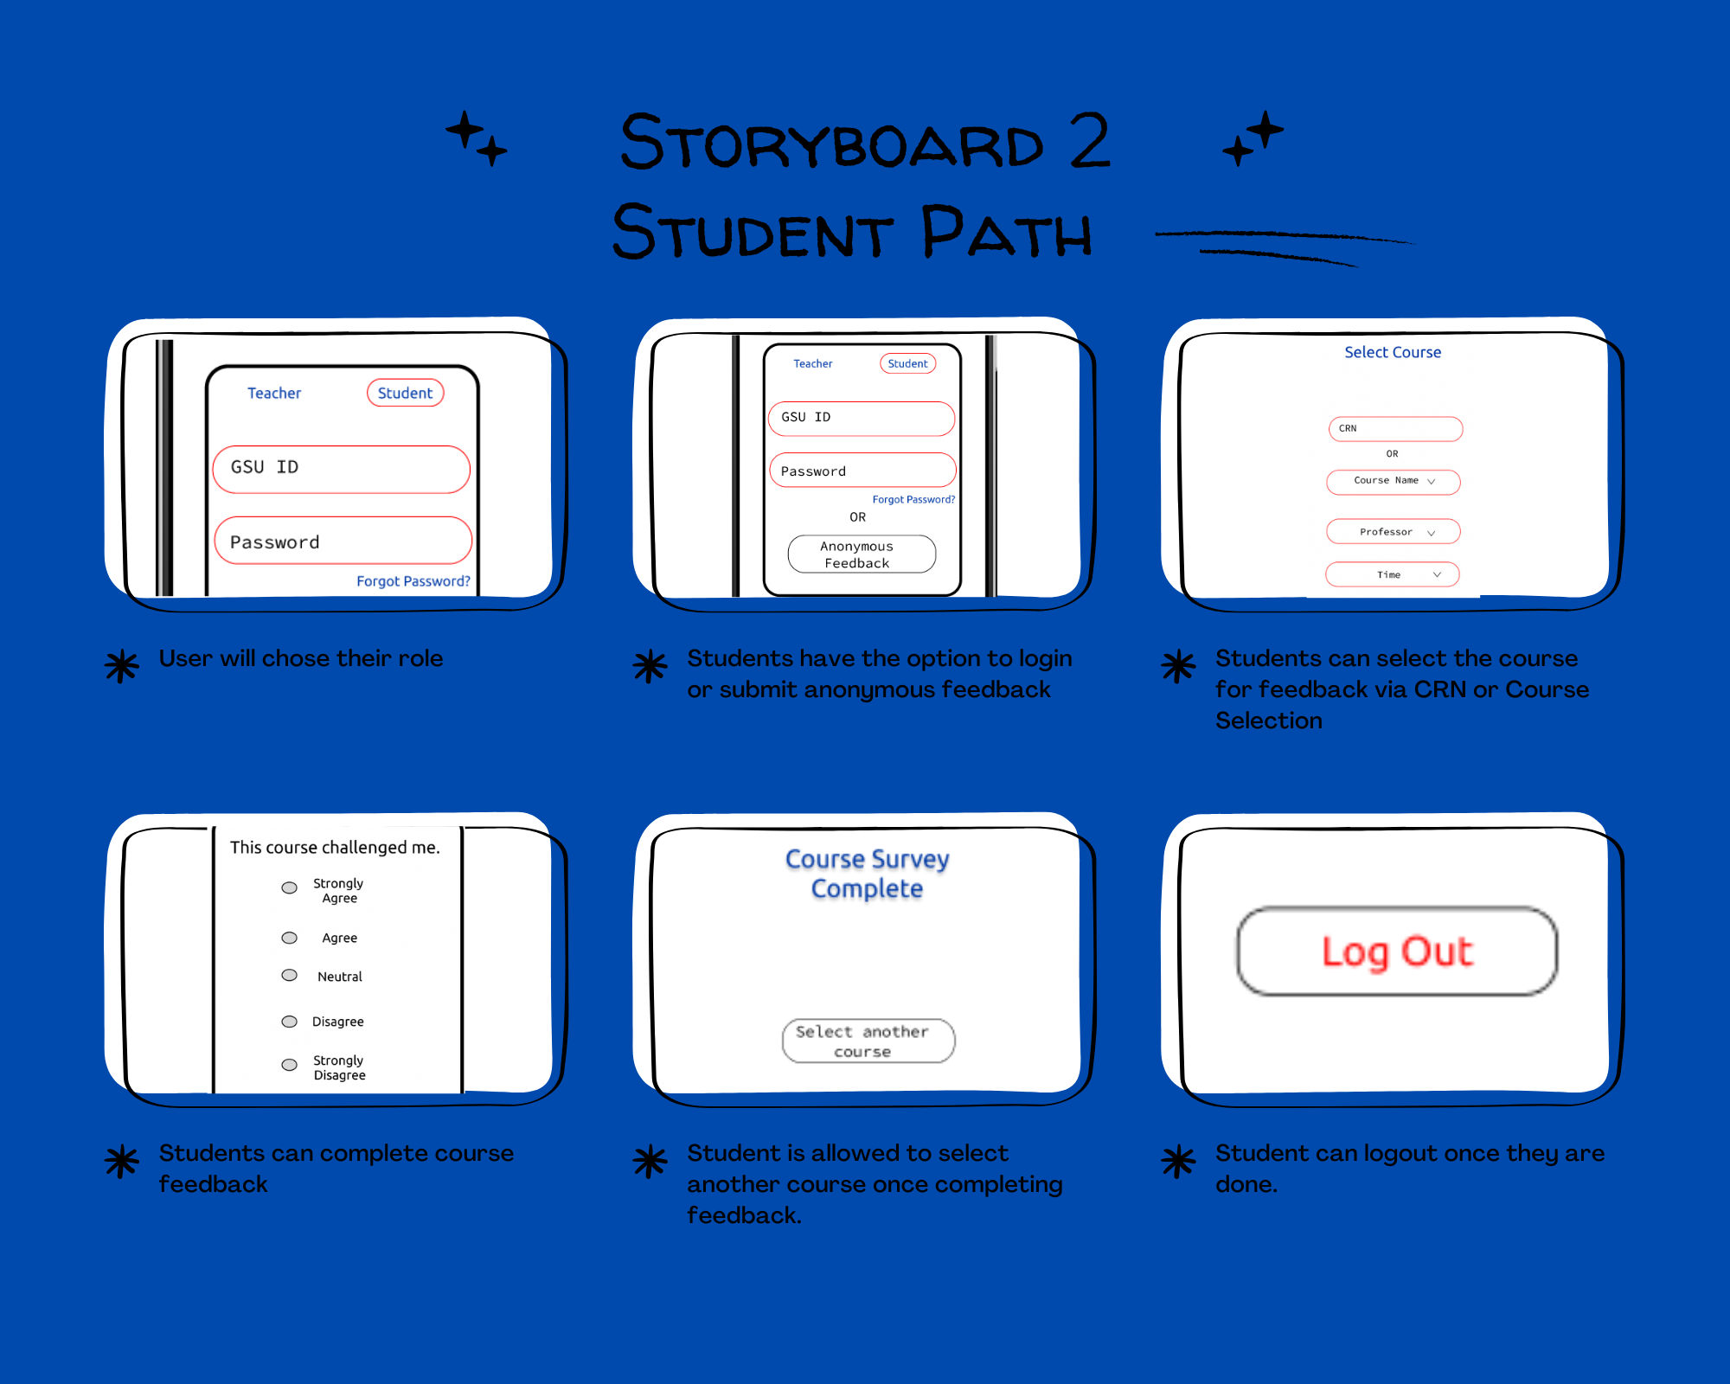

Slide 9
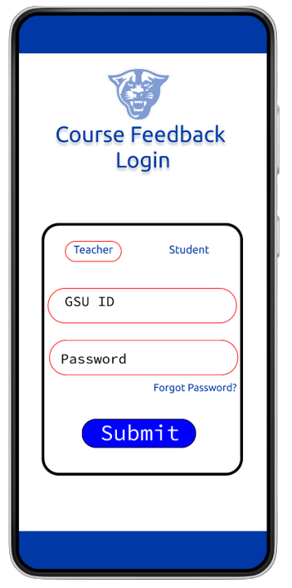
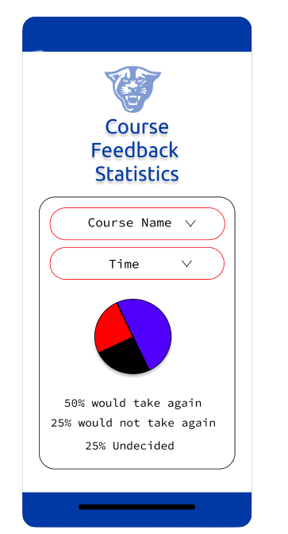
Mobile View
Demo

Slide 10

Thanks!
Any questions?

